Slide 1
Assignment: Uber Supply - Demand Gap
By Suresh Balla

Slide 2
Business Objectives
The aim of analysis is to identify the root cause of the problem (i.e. cancellation and non-availability of cars) and recommend ways to improve the situation

Slide 3
New Derived Dimensions
Request date (0 to 31)
Request hour (0 to 23)
Request time slots
mid night to 4 am: night
4 am to 8 am: early morning
8 am to 12 pm: late morning
12 pm to 1 pm: noon
1 pm to 3 pm: early afternoon
3 pm to 6pm: late afternoon
6 pm to 9 pm: early evening
9 pm to mid night: late evening
Request Day (Sunday to Saturday)
Request Month (Calendar months – Jan to Dec)
Request Quarter (Q1, Q2, Q3 and Q4)
Request Week (weekdays and weekends, not used for analysis as request data is available only for week days)
Request Ride Duration (not used for analysis, as it is only applicable for trips completed)
Request Ride Duration Class (short, medium and long – not used for analysis, as it is only applicable for trips completed)

Slide 4
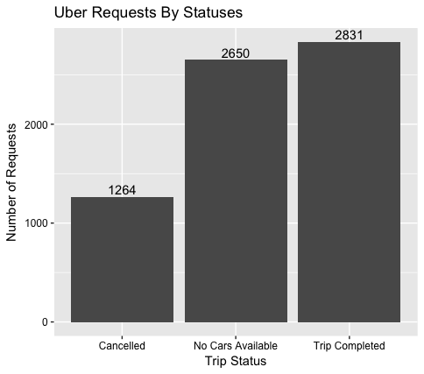
Uber Requests By Statuses
Unfulfilled request are way more than fulfilled requests leading to huge supply demand gap

Slide 5
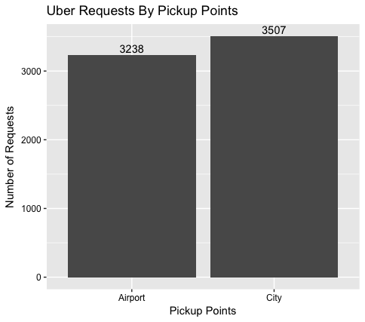
Uber Requests By Pickup Points
City pickup points has more demands compared to Airport pickup point

Slide 6
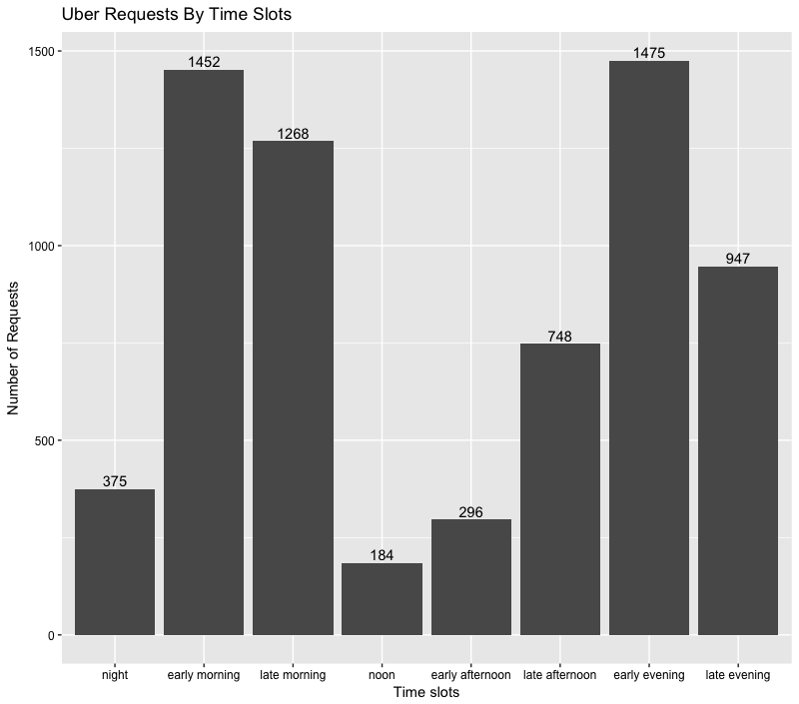
Uber Requests By Time Slots
Demand is more during mornings and evenings

Slide 7
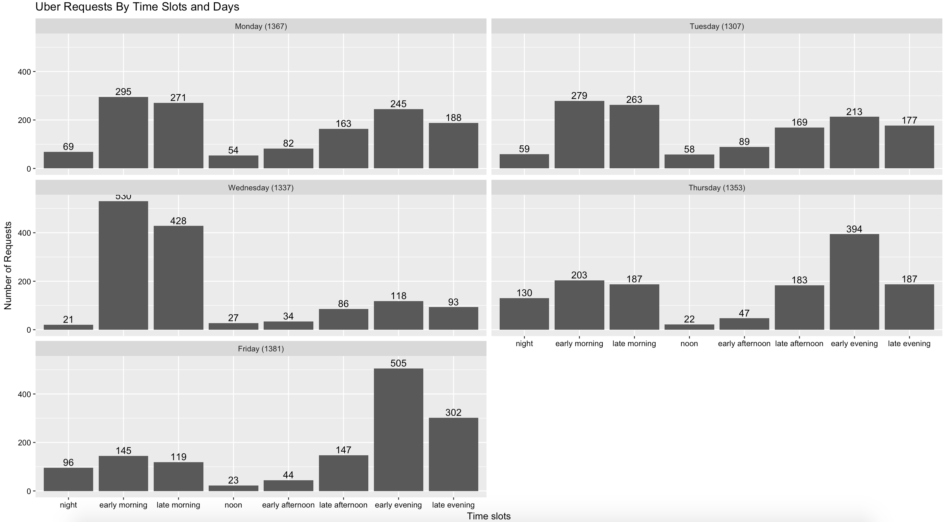
Uber Requests By Time Slots and Days
Mondays and Fridays are more busy days than mid week days

Slide 8
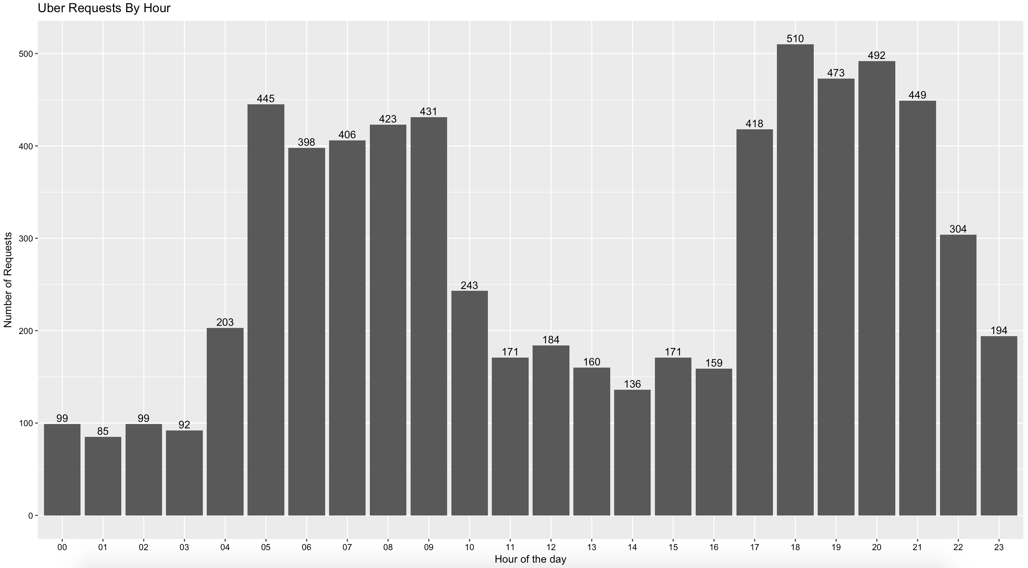
Uber Requests By Hour
Mornings 5 am to 10 am and Evenings are 5 pm to 11 pm are buys hours

Slide 9
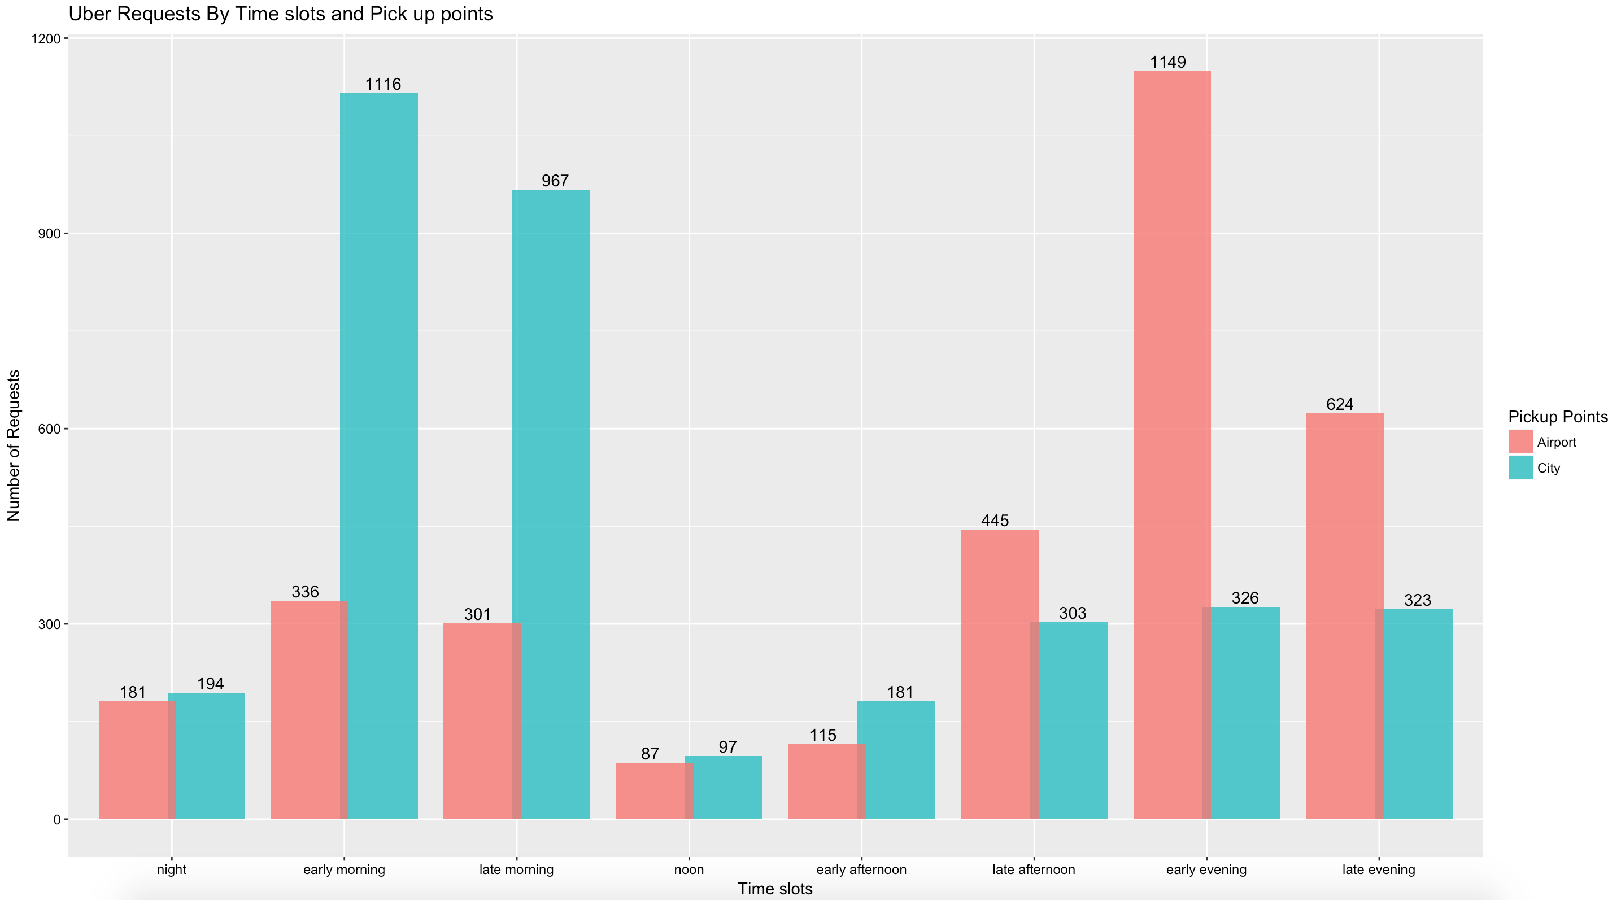
Request analysis by time slot and pick up point
Most request to airport is from early and late mornings
Most request from airport is from early and late evenings

Slide 10
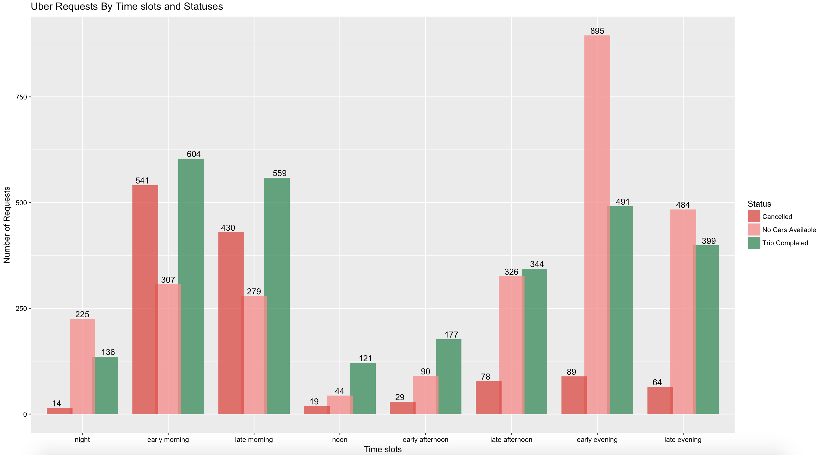
Uber Requests By Time slots and Statuses
Most cancellations are happening in early and late mornings
Most cars are not available in early and late evenings

Slide 11
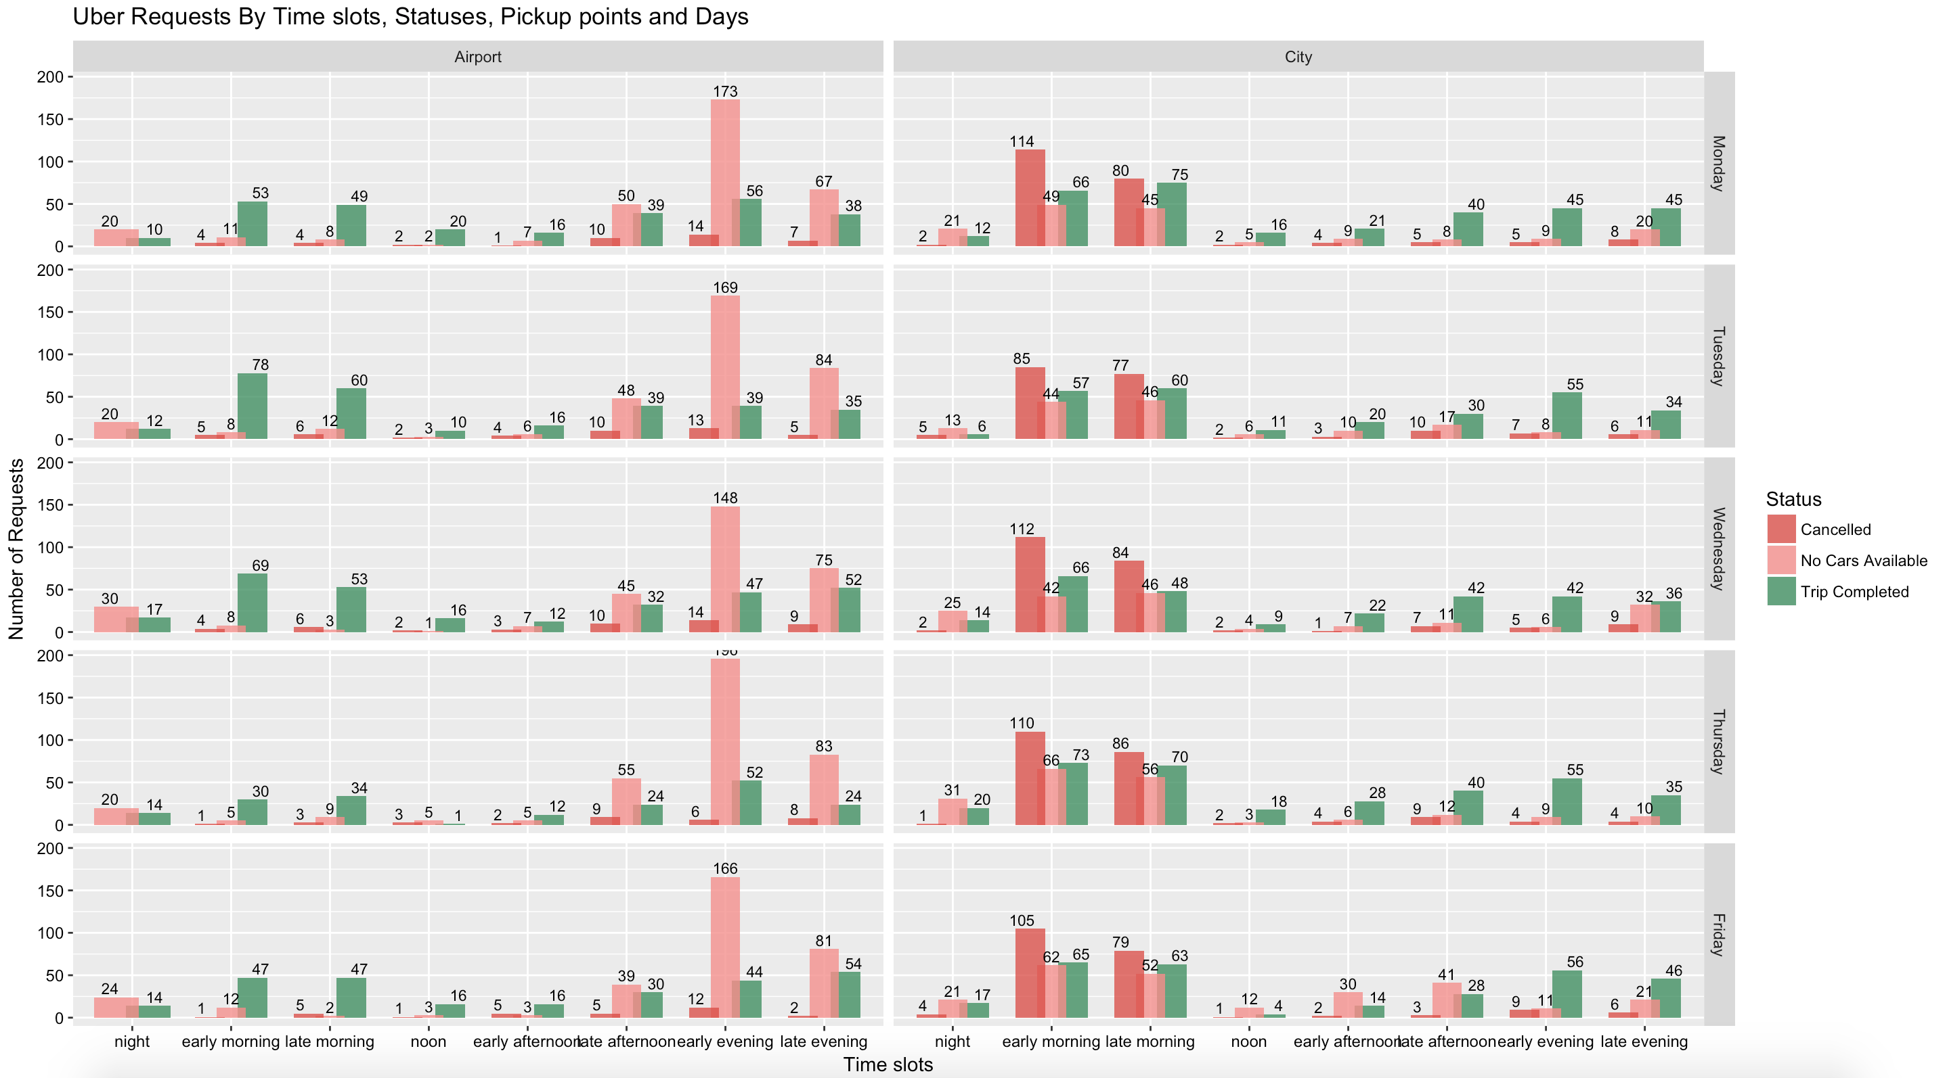
Uber Requests By Time slots, Statuses, Pickup points and Days
Most cars are not available in early and late evenings for airport pickup point
Most cancellations are happening in early and late mornings for city pickup points

Slide 12
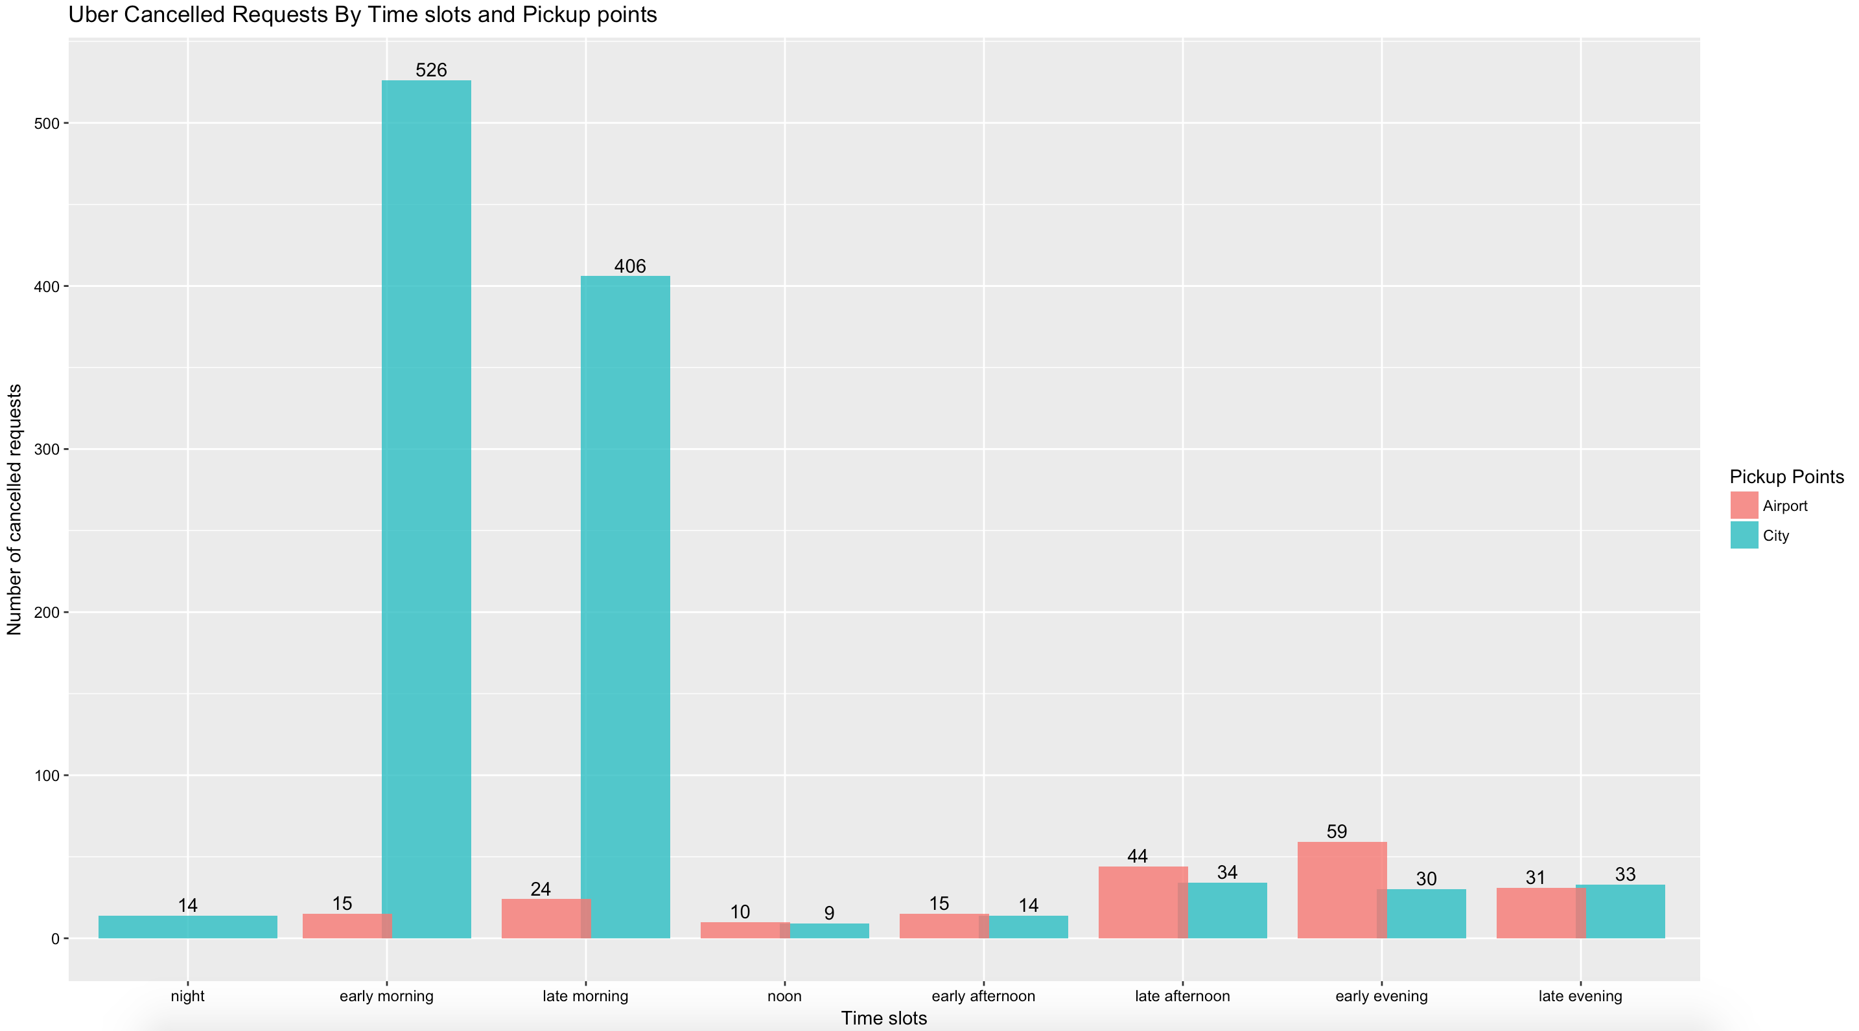
Uber Cancelled Requests By Time slots and Pickup points
Most cancellations are happening in early and late mornings for city pick up point

Slide 13
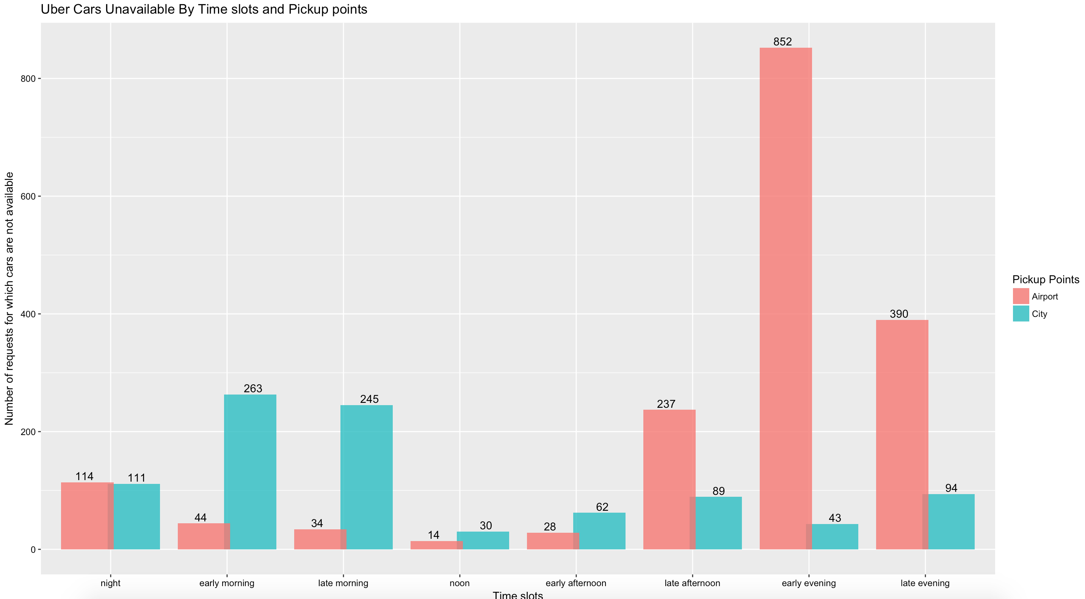
Uber Cars Unavailable By Time slots and Pickup points
Most cars are not available in in early and late evenings from airport pick up point

Slide 14
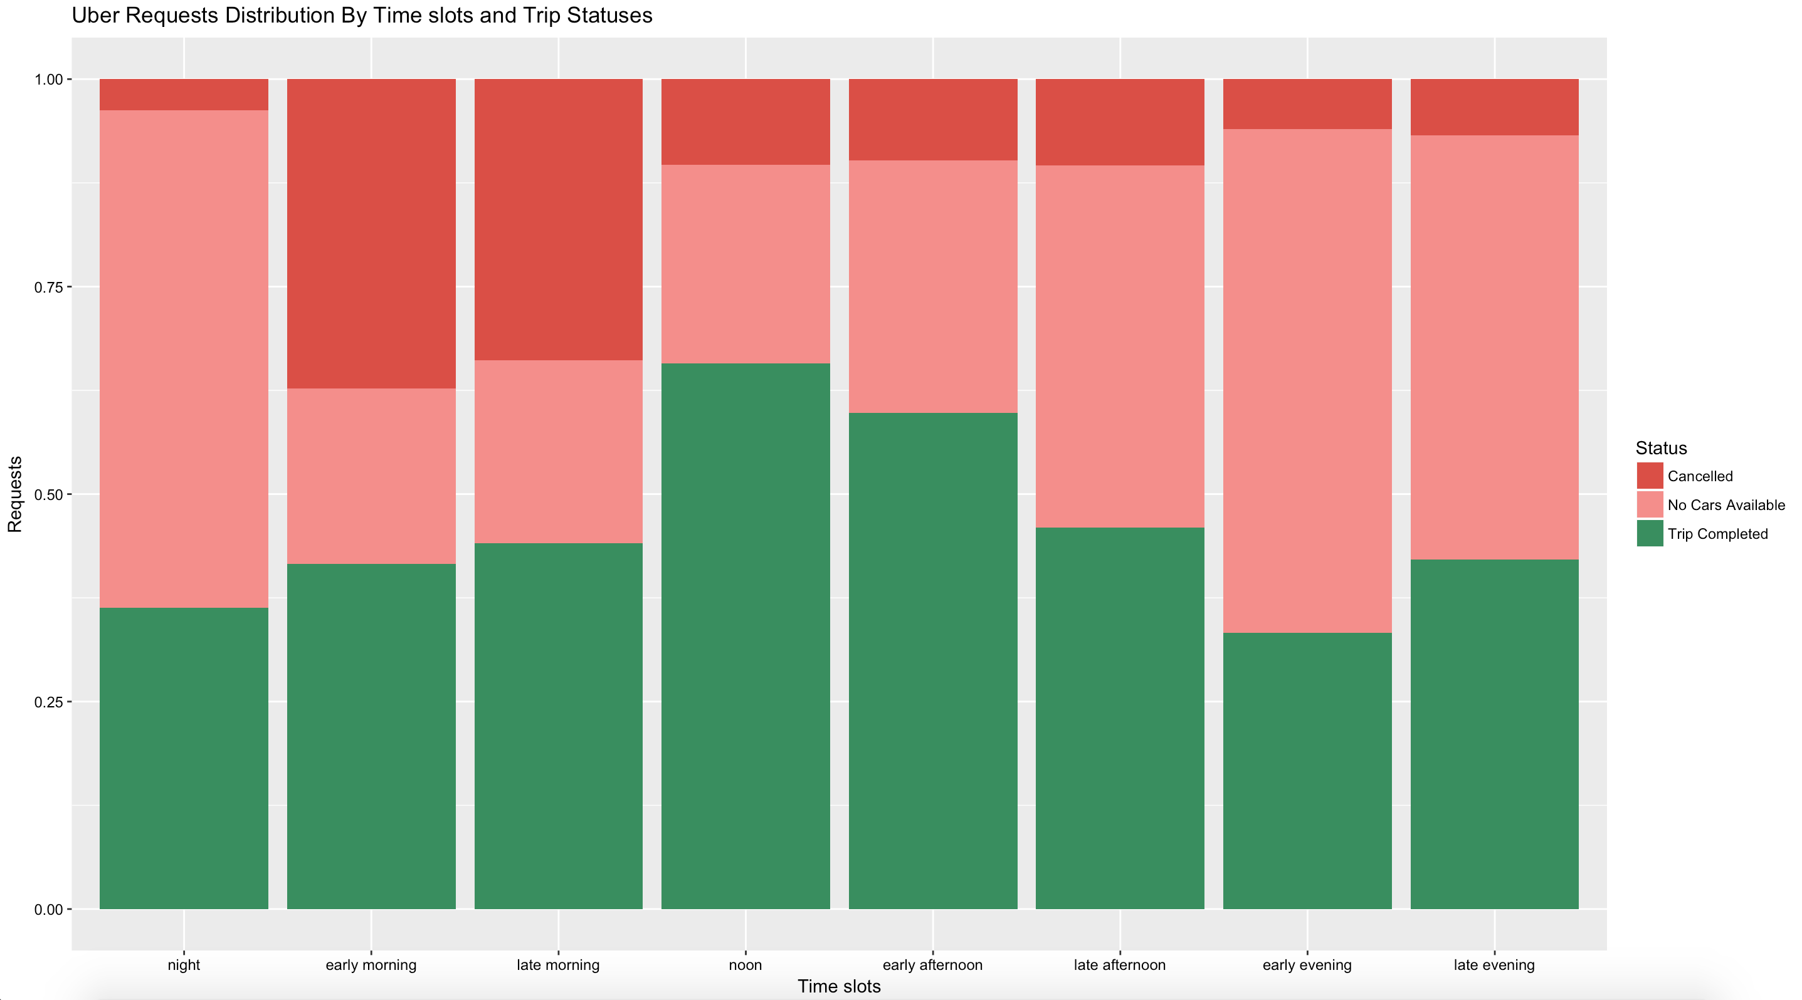
Uber Requests Distribution By Time slots and Trip Statuses
Highest gap percentage exists in night and early evenings

Slide 15
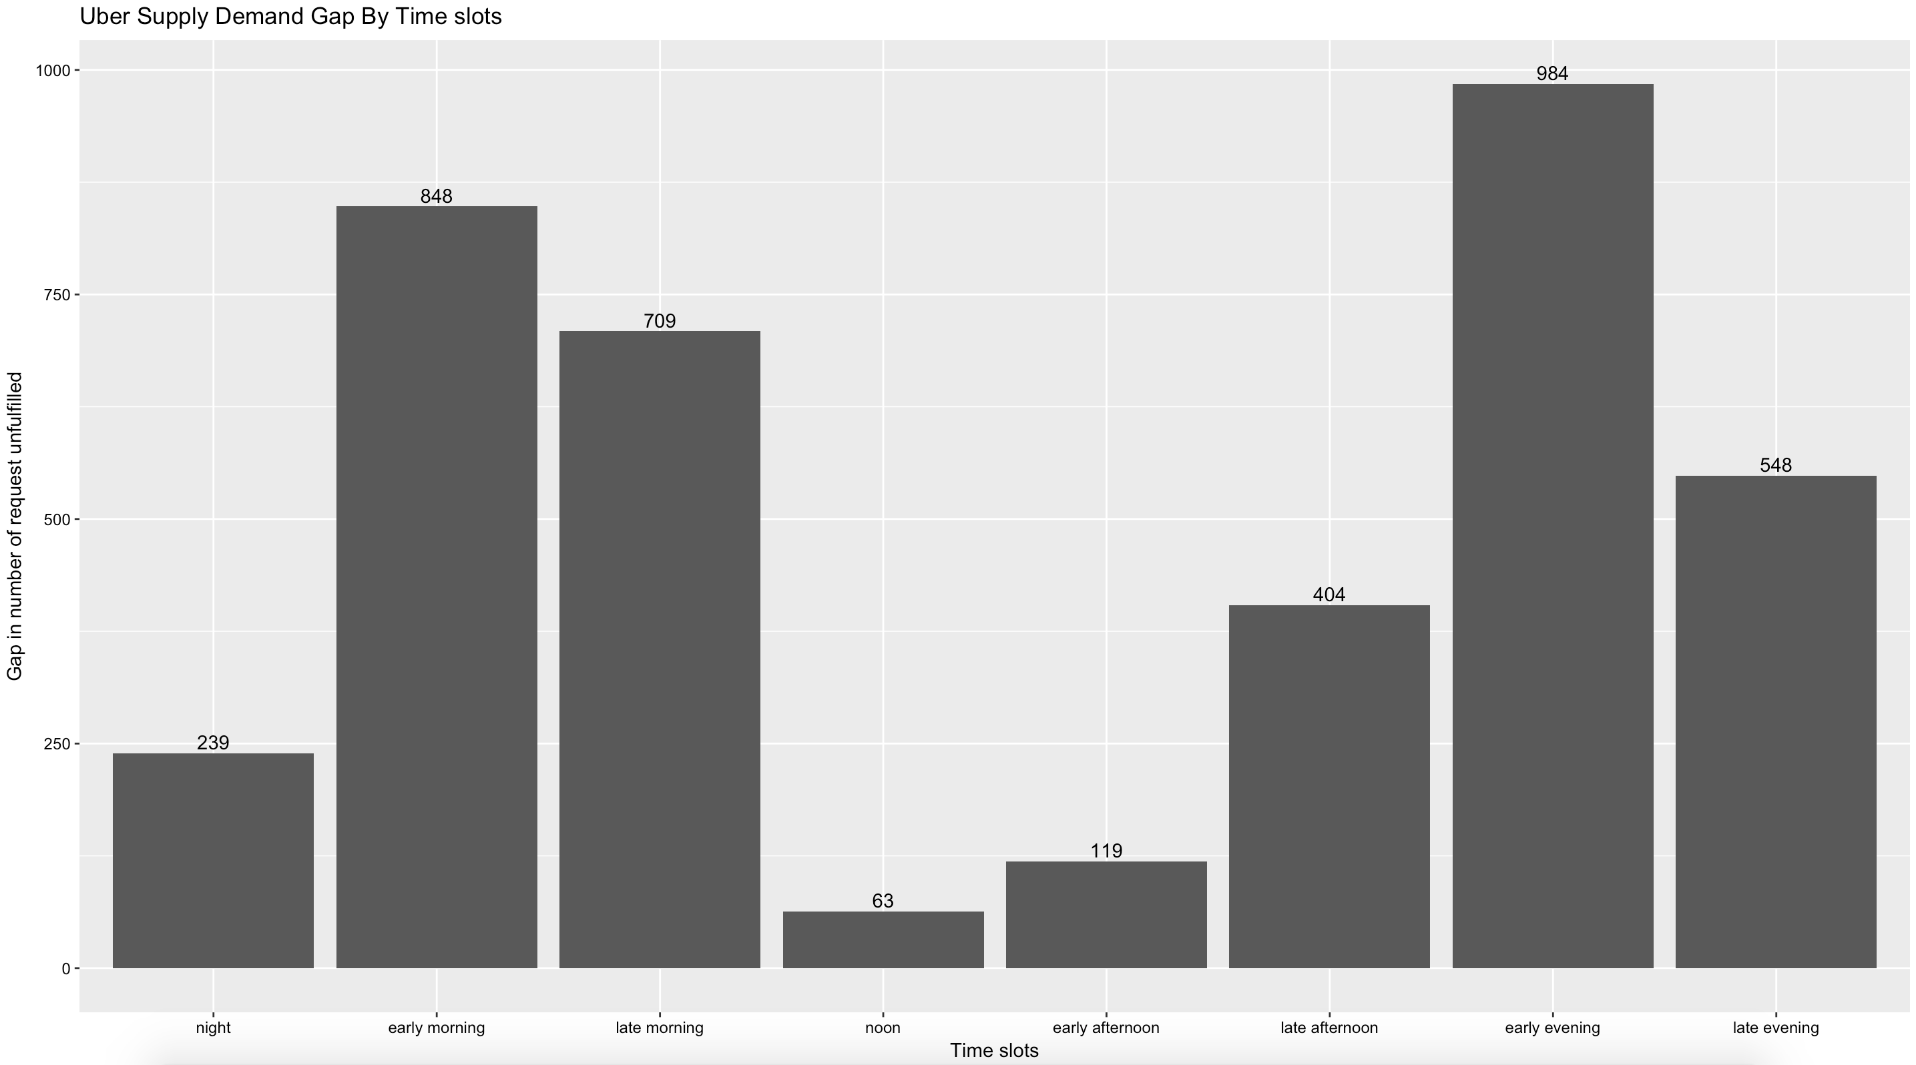
Uber Supply Demand Gap By Time slots
*Numbers indicates total number of cancelled and no cars available
Highest gaps in terms of failed request are more in evenings and then followed by mornings

Slide 16
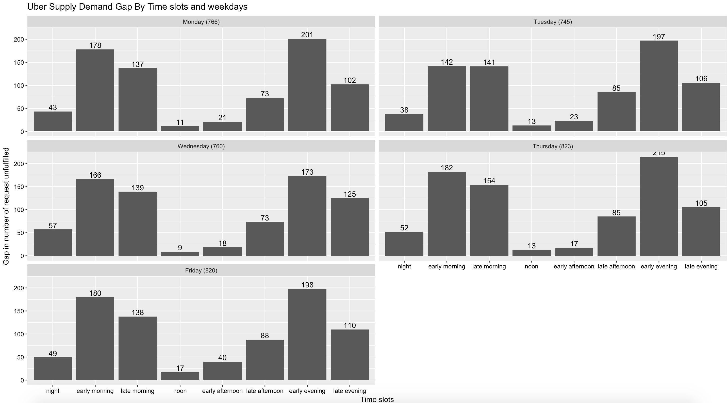
Uber Supply Demand Gap By Time slots and weekdays
*Numbers indicates total number of cancelled and no cars available
Highest gaps in terms of failed request are more for Thursdays and Fridays

Slide 17
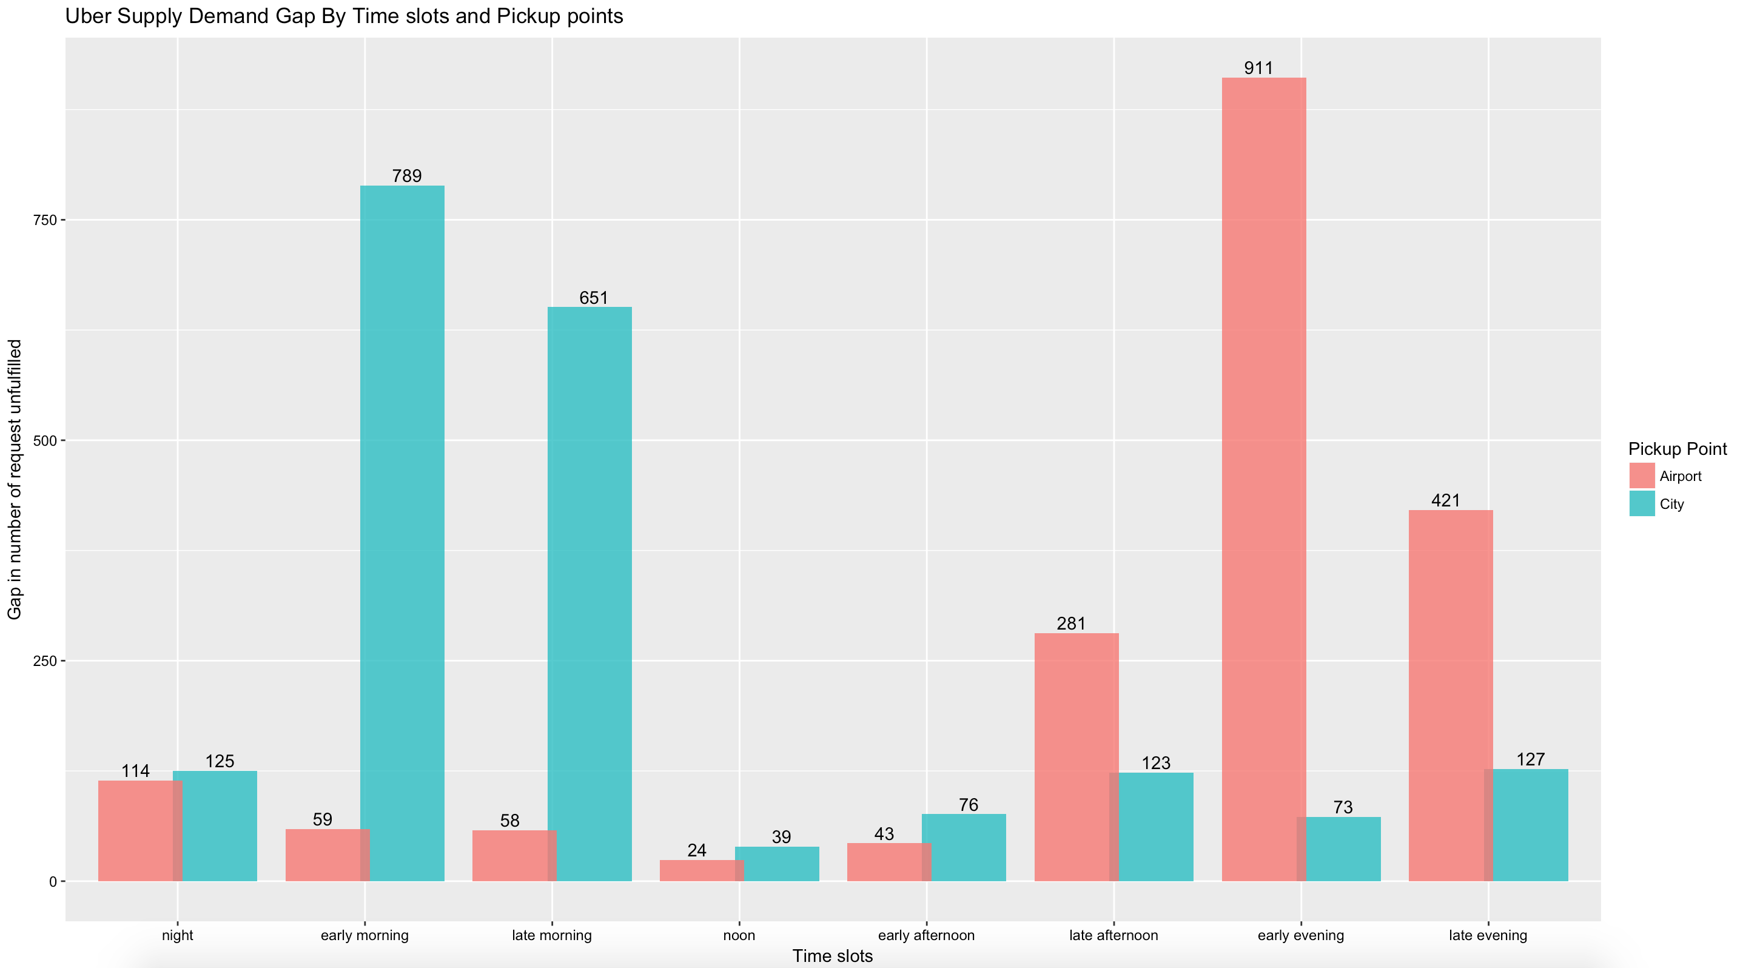
Uber Supply Demand Gap By Time slots and Pickup points
*Numbers indicates total number of cancelled and no cars available
Highest gaps in terms of failed request are more in evenings because of trips not being available from airport
Second highest gaps in terms of failed request are in mornings because of trips not being available from city

Slide 18
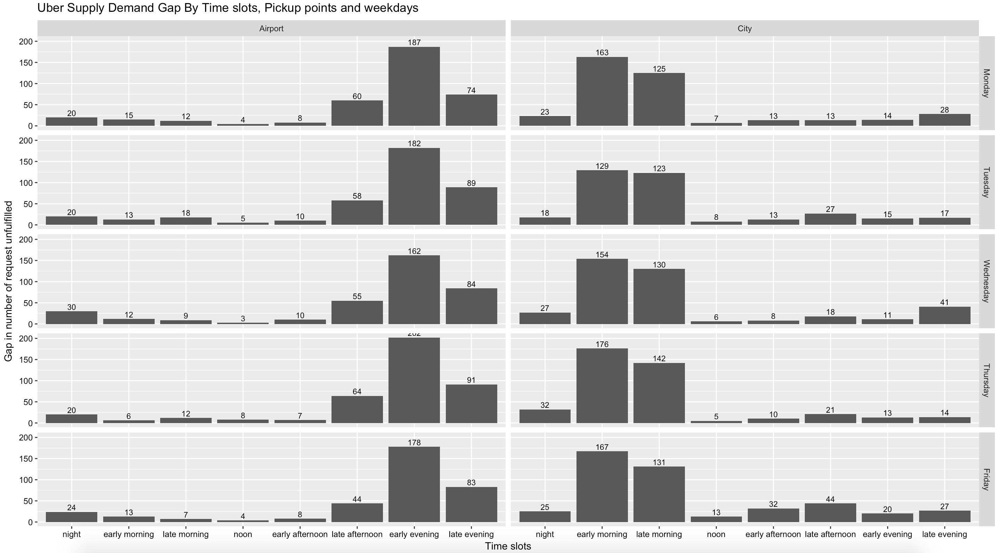
Uber Supply Demand Gap By Time slots, Pickup points and weekdays
*Numbers indicates total number of cancelled and no cars available
Highest gaps in terms of failed request are more for Thursdays.
This may be because Wednesday mid night flow to airport is less
(city gap is highest Wednesday late evening (41) and night (32)

Slide 19
Uber Cab Requests Facts
Unfulfilled request (3914) are way more than fulfilled requests (2831) leading to huge supply demand gap
Demand is more during mornings (5 am to 10 am) and evenings (5 pm to 11 pm)
City pickup points has more demands compared to Airport pickup point
Mondays and Fridays are more busy days than mid week days
Most request to airport is from early and late mornings
Most request from airport is from early and late evenings
Most cars are not available in early and late evenings for airport pickup point
Most cancellations are happening in early and late mornings for city pickup points
Highest gap percentage exists in night and early evenings
Highest gap in terms of failed request are more in evenings and then followed by mornings
Highest gap in terms of failed requests are more for Thursdays and Fridays
Highest gap in terms of failed requests are more in evenings because of trips not being available from airport
Second highest gap in terms of failed request are in mornings because of trips not being available from city

Slide 20
Uber Supply Demand Gap Reasons and Recommendations
Facts: Most cancellations are happening in early and late mornings for city pickup points. Most cars are not available in early and late evenings for airport pickup point.
Possible Reasons:
This may be because there are less in bound flights post morning due to which idle time for driver might be more or have to travel back city alone. Due to this reason, driver might cancel morning requests leading to less cabs availability at airport for evenings
Drivers may prefer to go to airport and stay near airport and pickup incoming passengers the next day morning. So this might support fact that gap is less in mornings from airport and evenings from city pickup points
Recommendations:
Give incentives to driver who will wait till evening in event there are no request to come back to city around noon. This incentive can be based on waiting time at airport or increased profit for evening return trip fare from airport. Make sure this incentive doesn't result in overall reduced profit for Uber.
Facts: Highest gap in terms of failed request are more for Thursdays and Fridays
Possible Reasons:
This may be because Wednesday mid night flow to airport is less (city gap is highest Wednesday late evening (41) and night (32)
Recommendations:
May be more incentives to driver on Thursday and Fridays than other days

